Slide 1

LLM Base Sindhi Health Text Generator Using RAG Technique
SHAHEED BENAZIR BHUTTO UNIVERSITY, SHAHEED BENAZIRABAD
Knowledge Commitment Leadership
Group Members
Muhammad Yousif 22 (BSIT)-15
Hajan 22 (BSIT)-28
Muhammad Danyal Javed 22 (BSIT)-36
Name of Supervisor: Dr. Azeem Ayaz Mirani

Slide 2
Presentation Outline
Introduction
Background and Motivation / Problem Statement
Literature Review
Aim and Objectives
Methodology
Project Timeline
Results and Discussion
Conclusion (Final Note)
Limitations
Future Work
References

Slide 3
Introduction
This project is about initial model Prototype for generating Sindhi text in the health domain. It fills the gap in digital tools for Sindhi, especially in scientific fields. Using the RAG (Retrieval-Augmented Generation) [6] technique, the system produces accurate and useful content. Data was collected from Sindhi textbooks, newspapers, novels, and web sources.
This work supports access to health information [7] in the Sindhi language and promotes its digital development.

Slide 4
Background
Sindhi is a low-resource language with very few NLP tools, especially for text generation and scientific domains like education and health. There is no existing work using RAG for Sindhi, and no health-specific datasets are available.
Also, current systems don’t focus on ethical or respectful communication with users. Our project aims to fill these gaps by building a content generator that is both knowledgeable and polite, tailored for Sindhi speakers.

Slide 5
Motivation
The main goal is to advance the use of Sindhi language in NLP and bridge the gap in education and technology. By creating tools for health, we aim to make Sindhi more accessible in the digital world, allowing speakers to interact with advanced systems.
“Our vision is to continuously improve and expand Sindhi’s role in NLP, making it smarter and more relevant for future use”.

Slide 6
Problem Statement
Although there have been advancements in NLP for various languages, Sindhi language still lacks comprehensive tools and datasets, particularly in the health sectors. This results in limited access to essential information for Sindhi-speaking community.
The challenge lies in developing a way to build an application that can generate reliable and clear content in Sindhi

Slide 7
Relevant Work / Literature Review
Ref | Title | Summary | Remarks
[1] | Sindhi Language Processing on Online SindhiNLP Tool | Describes the SindhiNLP tool and its functionalities for various NLP tasks in Sindhi, such as lemma, stemming, POS tagging. | Sindhi NLP tool.
[2] | Word Embedding based New Corpus for Low-resourced Language: Sindhi | Develops a large corpus for Sindhi language and trains word embeddings, evaluating them and comparing with Sindhi fastText. | Sindhi language corpus and word embeddings.
[3] | SiNER: A Large Dataset for Sindhi Named Entity Recognition | Introduces a new dataset for Sindhi Named Entity Recognition with quality baselines using CRF and Bi-LSTM models. | Sindhi NER dataset.

Slide 8
Aim and Objectives
To develop a health-focused text generation system for the Sindhi language using the Retrieval-Augmented Generation (RAG) technique.
To collect, clean, and preprocess Sindhi language data from health-related sources such as textbooks, newspapers, and online articles for model training.
To bridge the digital and linguistic gap by promoting Natural Language Processing (NLP) tools in the under-resourced Sindhi language, especially in the healthcare domain.
To evaluate the quality, accuracy, and usefulness of the generated Sindhi health texts through expert feedback and NLP metrics.

Slide 9
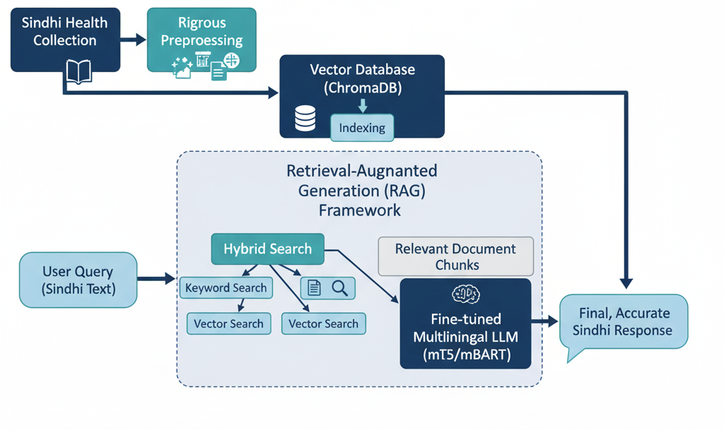




End-to-End Methodology for the Sindhi Health Text Generator

Slide 10
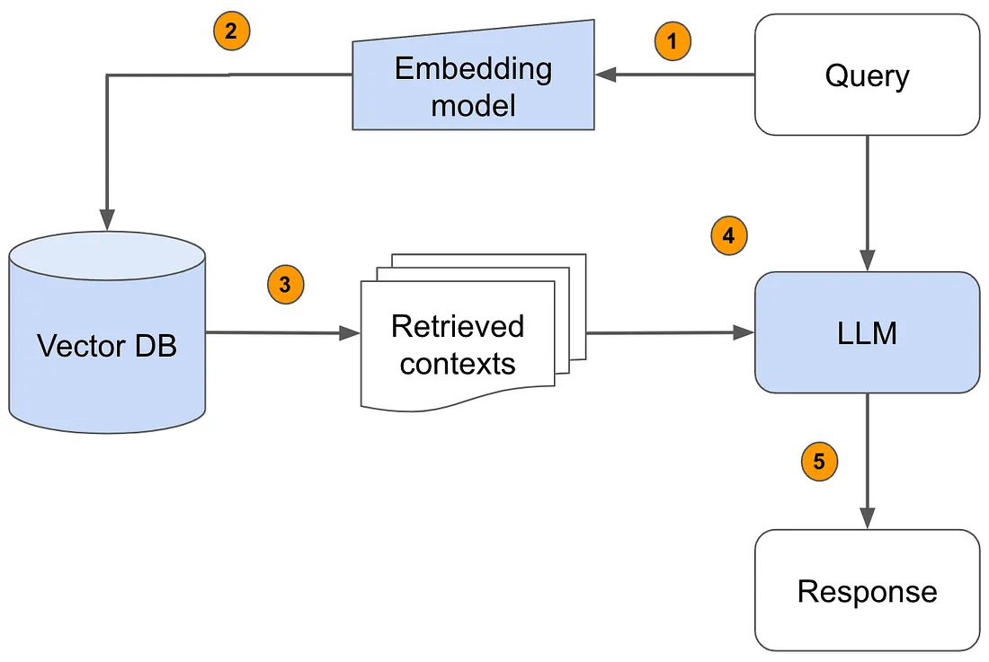



End-to-End Methodology for the Sindhi Health Text Generator

Slide 11
Scope / Application
Education: learners can ask questions about health in Sindhi.
Health Communication: Simplified health info in native language
Language Tech: Supports growth of Sindhi NLP
Community: Promotes digital use of regional language

Slide 12
Project Timeline
Month | Activities
February 2025 | Finalize objectives, workflow, roles | Review LLMs and tools
March 2025 | Expand data collection | reprocess data
April 2025 | Develop model with Sciket | Implement RAG | Integrate health/Sindhi nuances
May 2025 | Conduct tests | Gather feedback | Refine model and document findings
June 2025 | Build UI with Streamlit | Deploy to the cloud | Perform system testing
July 2025 | Write thesis on methodology, findings, and outcomes with visuals
August 2025 | Evaluate accuracy | Refine based on feedback | Finalize metrics
September 2025 | Complete final report | Present findings | Submit version for review

Slide 13
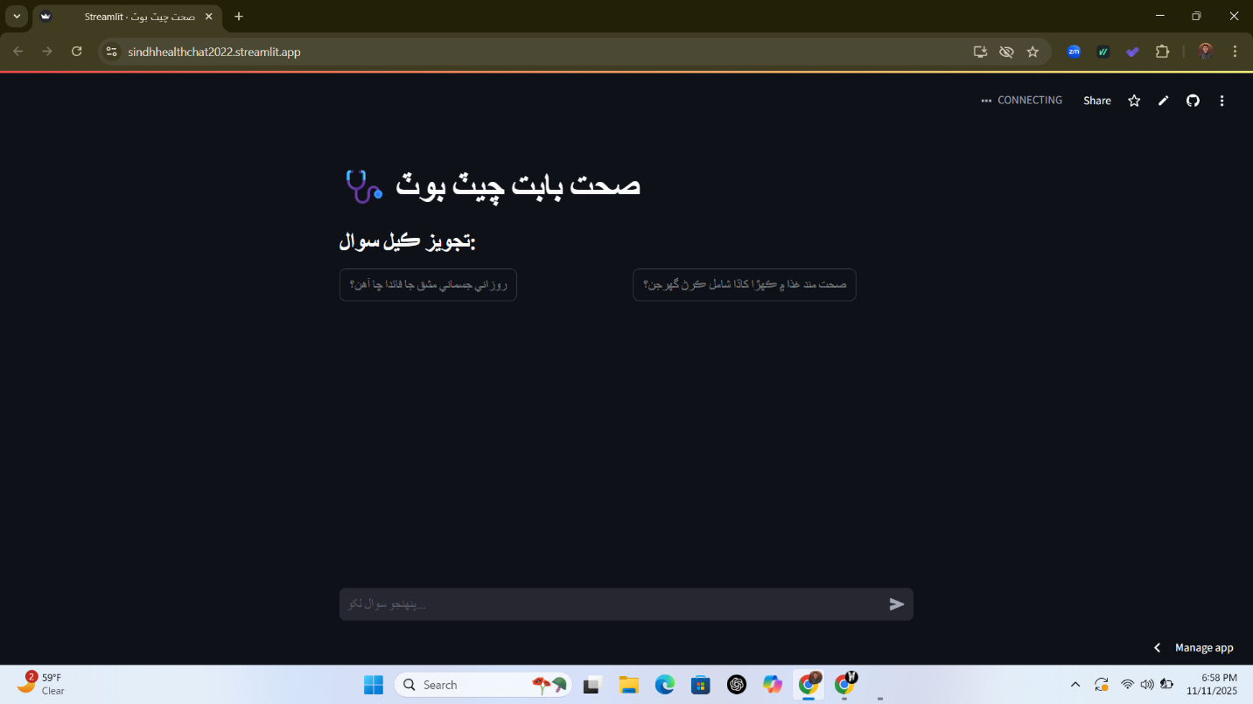
INTERFACE

Slide 14
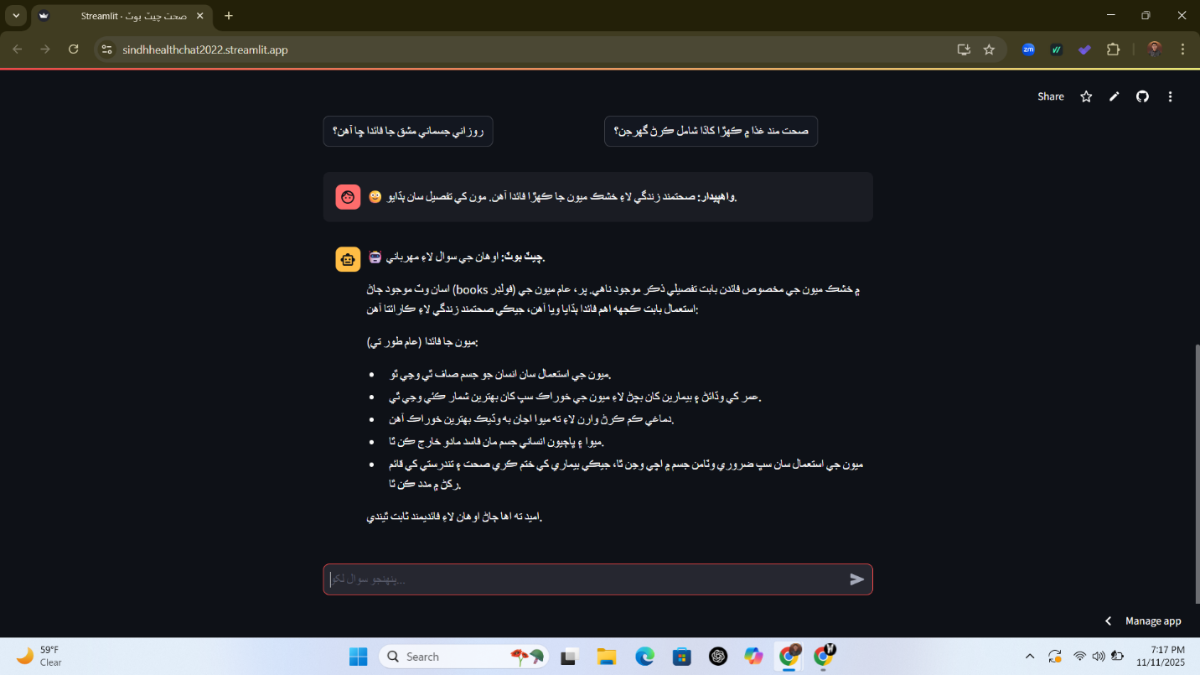
INTERFACE
Calibri

Slide 15
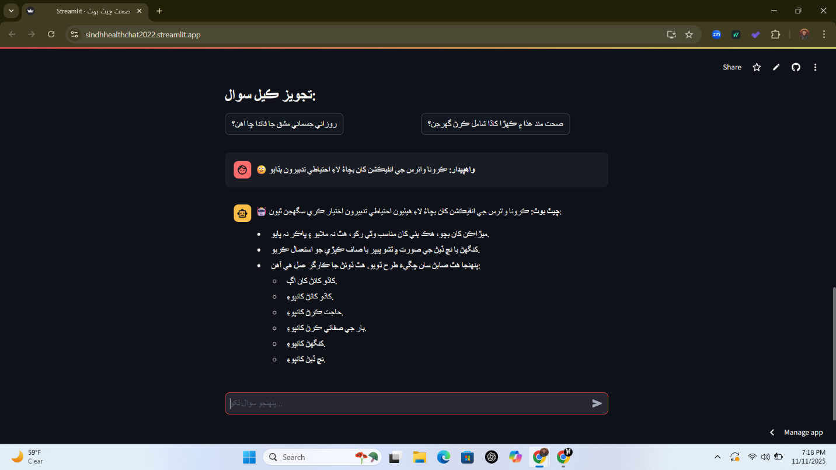
INTERFACE

Slide 16
Results
Retrieval Performance:
Precision@k: 0.82 82% of retrieved documents were relevant
Recall@k: 0.76 Strong ability to find relevant information
F1-Score: 0.79 Balanced performance between precision and recall
Generation Quality:
Factual Accuracy: 81% Verified by medical professionals
Fluency Score: 78% Assessed by native Sindhi speakers
Comparative Improvement:
+24.6% higher factual accuracy than baseline model without RAG

Slide 17
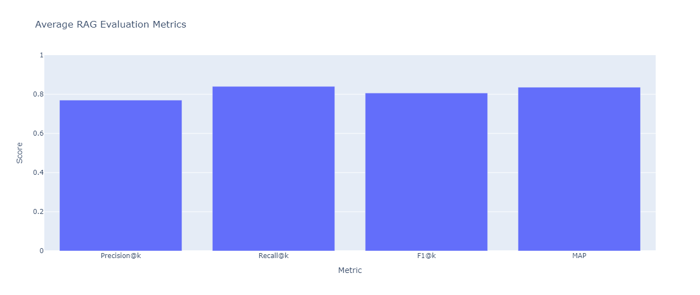
Average RAG Evaluation Metrics

Slide 18
Conclusion
“We leave behind a foundation a proven framework, a valuable corpus, and a functional tool that will empower future innovators to ensure no language is left behind in the digital health revolution.”

Slide 19
Limitations
Challenges Overcome:
Data Scarcity: Data Scarcity & OCR errors in Sindhi textbooks.
Computational Limits: Computational limitations for model training.
Limitations (Be Transparent):
Static Knowledge: Corpus is based on textbooks(not up-to-date with latest research)
Formal Tone: Outputs are educational, not conversational.
Ethical Guardrails (Crucial for Healthcare):
Clear Disclaimer: "This is an educational aid, not a medical diagnostic tool."
Privacy: User queries are not stored permanently.
Accessibility: We acknowledge the need for voice-based interfaces for wider reach in HCI field.

Slide 20
Future Work
The Road Ahead
Short-Term (Next 6 months):
Corpus expansion with latest guidelines & multimedia.
Develop a mobile application.
Medium-Term (Next 1-2 years):
Integrate Sindhi Text-to-Speech and Speech-to-Text.
Partnerships with health NGOs for real-world deployment.
Long-Term Vision:
"Sindhi Health AI Assistant": A multimodal, always-up-to-date health companion.
Adapt this framework for other Pakistani languages (Urdu, Pashto, Balochi).

Slide 21
References
[1] Memon, A. A., Hina, S., Kazi, A. K., & Ahmed, S. (2024). Parts-of-speech tagger for Sindhi language using deep neural network architecture. Mehran University Research Journal Of Engineering & Technology, 43(3), 47-55.
[2] Shaikh, I. A., Nawaz, H. I., & Abbasi, M. A. (2025). Exploring the Effects of English Language Dominance on Sindhi Language Speakers' Attitudes. Dialogue Social Science Review (DSSR), 3(1)
[3] Arora, P., Nathani, B., Joshi, N., & Katyayan, P. (2024, January). Development of Rule-Based Chunker for Sindhi. In International Conference on Computation of Artificial Intelligence & Machine Learning (pp. 102-112). Cham: Springer Nature Switzerland.
[4] Gupta, P. (2024). A Breadth-First Catalog of Text Processing, Speech Processing and Multimodal Research in South Asian Languages. arXiv preprint arXiv:2501.00029.
[5] Memon, A. A., Hina, S., Kazi, A. K., & Ahmed, S. (2024). Parts-of-speech tagger for Sindhi language using deep neural network architecture. Mehran University Research Journal Of Engineering & Technology, 43(3), 47-55.
[6] Ali, W., Tumrani, S., Kumar, J., & Soomro, T. R. (2024). An Evaluation of Sindhi Word Embedding in Semantic Analogies and Downstream Tasks. arXiv preprint arXiv:2408.15720.

Slide 22
References
[7] Bunnell, D. J., Bondy, M. J., Fromtling, L. M., Ludeman, E., & Gourab, K. (2025). Bridging AI and Healthcare: A Scoping Review of Retrieval-Augmented Generation-Ethics, Bias, Transparency, Improvements, and Applications. medRxiv, 2025-04.
[8] Singh, A. (2025). Future Prospects of Agentic RAG in Medical Research. Available at SSRN 5212343.
[9] Ng, K. K. Y., Matsuba, I., & Zhang, P. C. (2025). RAG in health care: a novel framework for improving communication and decision-making by addressing LLM limitations. NEJM AI, 2(1), AIra2400380.
[10] Amugongo, L. M., Mascheroni, P., Brooks, S. G., Doering, S., & Seidel, J. (2024). Retrieval Augmented Generation for Large Language Models in Healthcare: A Systematic Review.
[11] Quidwai, M. A., & Lagana, A. (2024). A rag chatbot for precision medicine of multiple myeloma. medRxiv, 2024-03.
[12] Raja, M., & Yuvaraajan, E. (2024, April). A rag-based medical assistant especially for infectious diseases. In 2024 International Conference on Inventive Computation Technologies (ICICT) (pp. 1128-1133). IEEE.

Slide 23

Thank you

